Slide 1
Python IOT
Microcontrollers, MicroPython, IO

Slide 2
Python IOT
What is a Microcontroller?
A microcontroller is a small computer on a single metal-oxide-semiconductor integrated circuit chip. A microcontroller contains one or more CPUs along with memory and programmable input/output peripherals.
https://en.wikipedia.org/wiki/Microcontroller

Slide 3
Python IOT
What is a Microcontroller?
Program memory in the form of ferroelectric RAM, NOR flash or OTP ROM is also often included on chip, as well as a small amount of RAM.
https://en.wikipedia.org/wiki/Microcontroller

Slide 4
Python IOT
What is a Microcontroller?
Microcontrollers are designed for embedded applications, in contrast to the microprocessors used in personal computers or other general purpose applications consisting of various discrete chips.
https://en.wikipedia.org/wiki/Microcontroller

Slide 5
Python IOT
What is a Microcontroller?
Microcontrollers are used in automatically controlled products and devices, such as automobile engine control systems, implantable medical devices, remote controls, office machines, appliances, power tools, toys and other embedded systems.
By reducing the size and cost compared to a design that uses a separate microprocessor, memory, and input/output devices, microcontrollers make it economical to digitally control even more devices and processes.
https://en.wikipedia.org/wiki/Microcontroller

Slide 6
Python IOT
What is a Microcontroller?
Mixed signal microcontrollers are common, integrating analog components needed to control non-digital electronic systems.
In the context of the internet of things, microcontrollers are an economical and popular means of data collection, sensing and actuating the physical world as edge devices.
https://en.wikipedia.org/wiki/Microcontroller

Slide 7
Python IOT
ESP32
https://www.youtube.com/watch?v=A5CB4t9sukM

Slide 8
Python IOT
ESP32
Robust Design
ESP32 is capable of functioning reliably in industrial environments, with an operating temperature ranging from –40°C to +125°C. Powered by advanced calibration circuitries, ESP32 can dynamically remove external circuit imperfections and adapt to changes in external conditions.
https://www.espressif.com/en/products/socs/esp32

Slide 9
Python IOT
ESP32
Ultra-Low Power Consumption
Engineered for mobile devices, wearable electronics and IoT applications, ESP32 achieves ultra-low power consumption with a combination of several types of proprietary software. ESP32 also includes state-of-the-art features, such as fine-grained clock gating, various power modes and dynamic power scaling.
https://www.espressif.com/en/products/socs/esp32

Slide 10
Python IOT
ESP32
High Level of Integration
ESP32 is highly-integrated with in-built antenna switches, RF balun, power amplifier, low-noise receive amplifier, filters, and power management modules. ESP32 adds priceless functionality and versatility to your applications with minimal Printed Circuit Board (PCB) requirements.
https://www.espressif.com/en/products/socs/esp32

Slide 11
Python IOT
ESP32
Hybrid Wi-Fi & Bluetooth Chip
ESP32 can perform as a complete standalone system or as a slave device to a host MCU, reducing communication stack overhead on the main application processor. ESP32 can interface with other systems to provide Wi-Fi and Bluetooth functionality through its SPI / SDIO or I2C / UART interfaces.
https://www.espressif.com/en/products/socs/esp32

Slide 12
Python IOT
TinyPICO
https://www.youtube.com/watch?v=H8Cmuj0_3Ts

Slide 13
Python IOT
GPIO – Tiny PICO
There are 20 pins on the GPIO:
One of the pins provides 5 volts
One pin provides 3.3 volts
One pin can be used to reset the tinyPICO
Two pins provide ground
Most of the remaining pins provide digital input / output of 3.3 volt

Slide 14
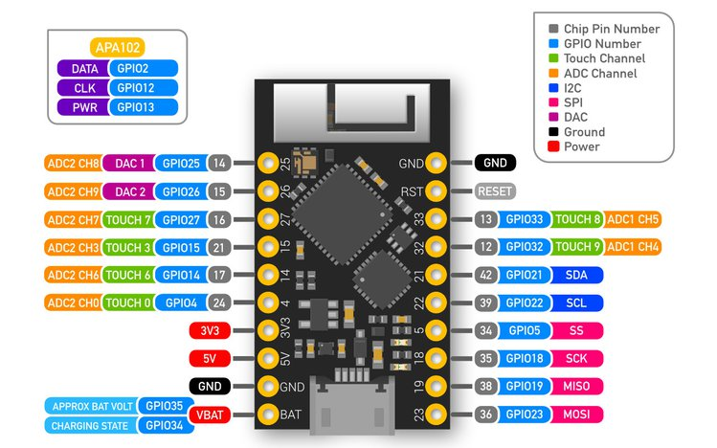
Python IOT
GPIO - tinyPICO

Slide 15
Python IOT
Python
According to Wikipedia:
Python is a widely used high-level, general-purpose, interpreted, dynamic programming language. Its design philosophy emphasizes code readability, and its syntax allows programmers to express concepts in fewer lines of code than possible in other popular programming languages.
In other words, it’s easy to learn and you can do a lot with it!

Slide 16
Python IOT
MicroPython
MicroPython is a lean and efficient implementation of the Python 3 programming language that includes a small subset of the Python standard library and is optimized to run on microcontrollers and in constrained environments.
https://micropython.org/

Slide 17
Python IOT
MicroPython
MicroPython is a full Python compiler and runtime that runs on the bare-metal. You get an interactive prompt (the REPL) to execute commands immediately, along with the ability to run and import scripts from the built-in filesystem. The REPL has history, tab completion, auto-indent and paste mode for a great user experience.
https://micropython.org/

Slide 18
Python IOT
Output Devices - LEDs
Examine the MicroPython machine.Pin class:
https://docs.micropython.org/en/v1.15/library/machine.Pin.html

Slide 19
Python IOT
Output Devices - LEDs
Let’s create a program that turns an LED on/off
Complete Python IOT examples 1-5
https://github.com/jgrissom/Python-IOT/tree/Lesson-01

Slide 20
Python IOT
MicroPython Functions
Let’s create a function to blink an LED using definite repetition
Complete Python IOT example 6
https://github.com/jgrissom/Python-IOT/tree/Lesson-01

Slide 21
Python IOT
MicroPython Scripts
Let’s save our function to blink an LED in a python script file
Complete Python IOT example 7
https://github.com/jgrissom/Python-IOT/tree/Lesson-01

Slide 22
Python IOT
MicroPython Boot Scripts
There are two important files that MicroPython looks for in the root of its filesystem. These files contain MicroPython code that will be executed whenever the board is powered up or reset (i.e. it 'boots').
https://learn.adafruit.com/micropython-basics-load-files-and-run-code/boot-scripts

Slide 23
Python IOT
MicroPython Boot Scripts
/boot.py - This file is run first on power up/reset and should contain low-level code that sets up the board to finish booting.
/main.py - If this file exists it's run after boot.py and should contain any main script that you want to run when the board is powered up or reset.
https://learn.adafruit.com/micropython-basics-load-files-and-run-code/boot-scripts

Slide 24
Python IOT
MicroPython Boot Scripts
Let’s create (or edit) the main.py
Complete Python IOT example 8
https://github.com/jgrissom/Python-IOT/tree/Lesson-01

Slide 25
Python IOT
Input Devices - Buttons
Let’s create a program that uses Input from a momentary switch
Complete Python IOT examples 9-10
https://github.com/jgrissom/Python-IOT/tree/Lesson-01

Slide 26
Python IOT
Input Devices - Buttons
Review the following article regarding Pull Up / Pull Down resistors
https://learn.sparkfun.com/tutorials/pull-up-resistors/all

Slide 27
Python IOT
Input / Output Practice
Complete Python IOT example 11
https://github.com/jgrissom/Python-IOT/tree/Lesson-01

Slide 28
Python IOT
MicroPython Switch Debounce
Event programming with a momentary switch is tricky due to switch bouncing
When 2 pieces of metal come into contact, they connect and disconnect several times before a solid connection is made
If you are attempting to determine if a button was pressed this will result in multiple “presses” being detected
This can be prevented using switch debouncing – there are hardware and software strategies for switch debouncing

Slide 29
Python IOT
MicroPython Switch Debounce
Review the following article about software switch debouncing
https://learn.adafruit.com/micropython-hardware-digital-i-slash-o/digital-inputs
Complete Python IOT example 12

Slide 30
Intro to Python & Raspberry Pi
Bits & Bytes – Morse Code
Thomas Edison is known as America’s greatest inventor. He invented the phonograph, the motion picture camera, and the light bulb.
He was also deaf.
Due to his hearing impairment, he learned to communicate with Morse Code. He proposed to his wife by tapping Morse Code on her palm. She responded by tapping “YES” on his palm.

Slide 31
Intro to Python & Raspberry Pi
Bits & Bytes – Morse Code
Using the circuit created in the lesson, create a simple Morse Code application:
Use the red button as the “short tap” button and the green button as the “long tap” button
When the “short tap” button is pressed the led and buzzer should turn on for .25 seconds and “ . ” should be displayed
When the “long tap” button is pressed the led and buzzer should be turned on for .5 seconds and “ _ ” should be displayed
The program should be launched immediately when the microcontroller is booted
https://en.wikipedia.org/wiki/Morse_code

